Slide 1
Bayes nets examples

Slide 2
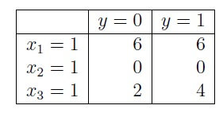
Consider a Naive Bayes problem with three features, x1 , x2 and x3. Imagine that we have seen a total of 12 training examples, 6 positive (with y= 1) and 6 negative (with y= 0). Below is a table with some of the counts:

Slide 3
Supply the following estimated probabilities. Show all your steps.
P (A| B) = P(A,B) / P(B)
Pr(x1 =1 | y=0) = P(x1=1, y=0) / P(y=0) = 6/8
Pr(x2 =1 | y=1) = P(x2=1, y=1) / P(y=1) = 0/10
Pr(x3 =0 | y=0) = P(x3=0, y=0) / P(y=0)
= ( 1 - P(x3=1, y=0)/P(y=0)) = 4/6
Note that to handle 0 probabilities it is better to add constants
Fort example instead of a/b you can use (a+C1)/(b+C2) where C1 and C2 are small constants

Slide 4
Consider the dataset given below for a Naïve Bayes Classification problem to decide whether a car is stolen or not given the features: Color, Type, Origin.
(Hint: You need to find out P (Yes | Color=Red, Type=SUV, Origin=Domestic) and P (No | Color=Red, Type=SUV, Origin=Domestic) to give the decision.Remember that the Naïve Bayes Classifier selects the most likely class CNB given the feature values f1, f2, ….., fn. That is: CNB = argmax cj є C P(cj) Π P(fi | cj), where cj is the jth class and fi is the ith feature.)

Slide 5
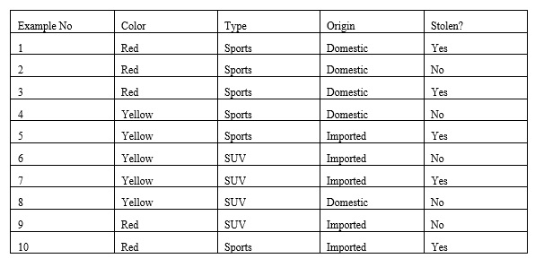
What is the classification output (Yes or No) for a car with features Color=Red, Type=SUV, Origin=Domestic? Clearly show all the steps to compute the result.

Slide 6
Since we will compare P(No| ….) with P(Yes|…) we can change P(….) with a constant
P (No | Color=Red, Type=SUV, Origin=Domestic) =
P(No, Color=Red, Type=SUV, Origin=Domestic) x constant
P (Yes | Color=Red, Type=SUV, Origin=Domestic) =
P(Yes, Color=Red, Type=SUV, Origin=Domestic) x constant
P(red | no) = P (red, no) / P(no) = 2/5
P(red | yes) = P(red, yes) / p (yes) = 3/5
P(suv | no) = 3/5
P (suv | yes) = 1/5
P(domestic | no ) = 3/5
P (domestic | yes) = 2/5
P(no, domestic, suv, red) = P (red|no) x P(suv | no) x P(domestic |no) x P(no)
= 2/5 x 3/5 x 3/5 x ½
P(yes, domestic, suv, red) = P (red|yes) x P(suv | yes) x P(domestic |yes) x P(yes)
3/5 x 1/5 x 2/5 x ½
Since P (No| …) > P (Yes | …) the answer is No

Slide 7
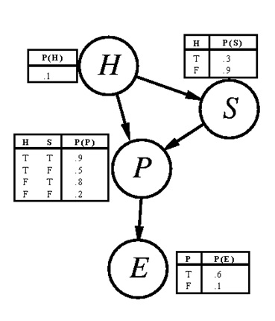
Consider the Bayesian Network below where H=Honest, S=Slick, P=Popular, E=Elected
Show how you can calculate the probability asked below. You are only required to provide the corresponding formula, not the exact values.

Slide 8
P(h,s,~p,~e) = P(h) x P( s | h ) x P(~p | h, s) x P(~e | ~p)
= 0.1 x 0.3 x (1-0.9) x (1-0.1) = 0.00027

